Slide 1
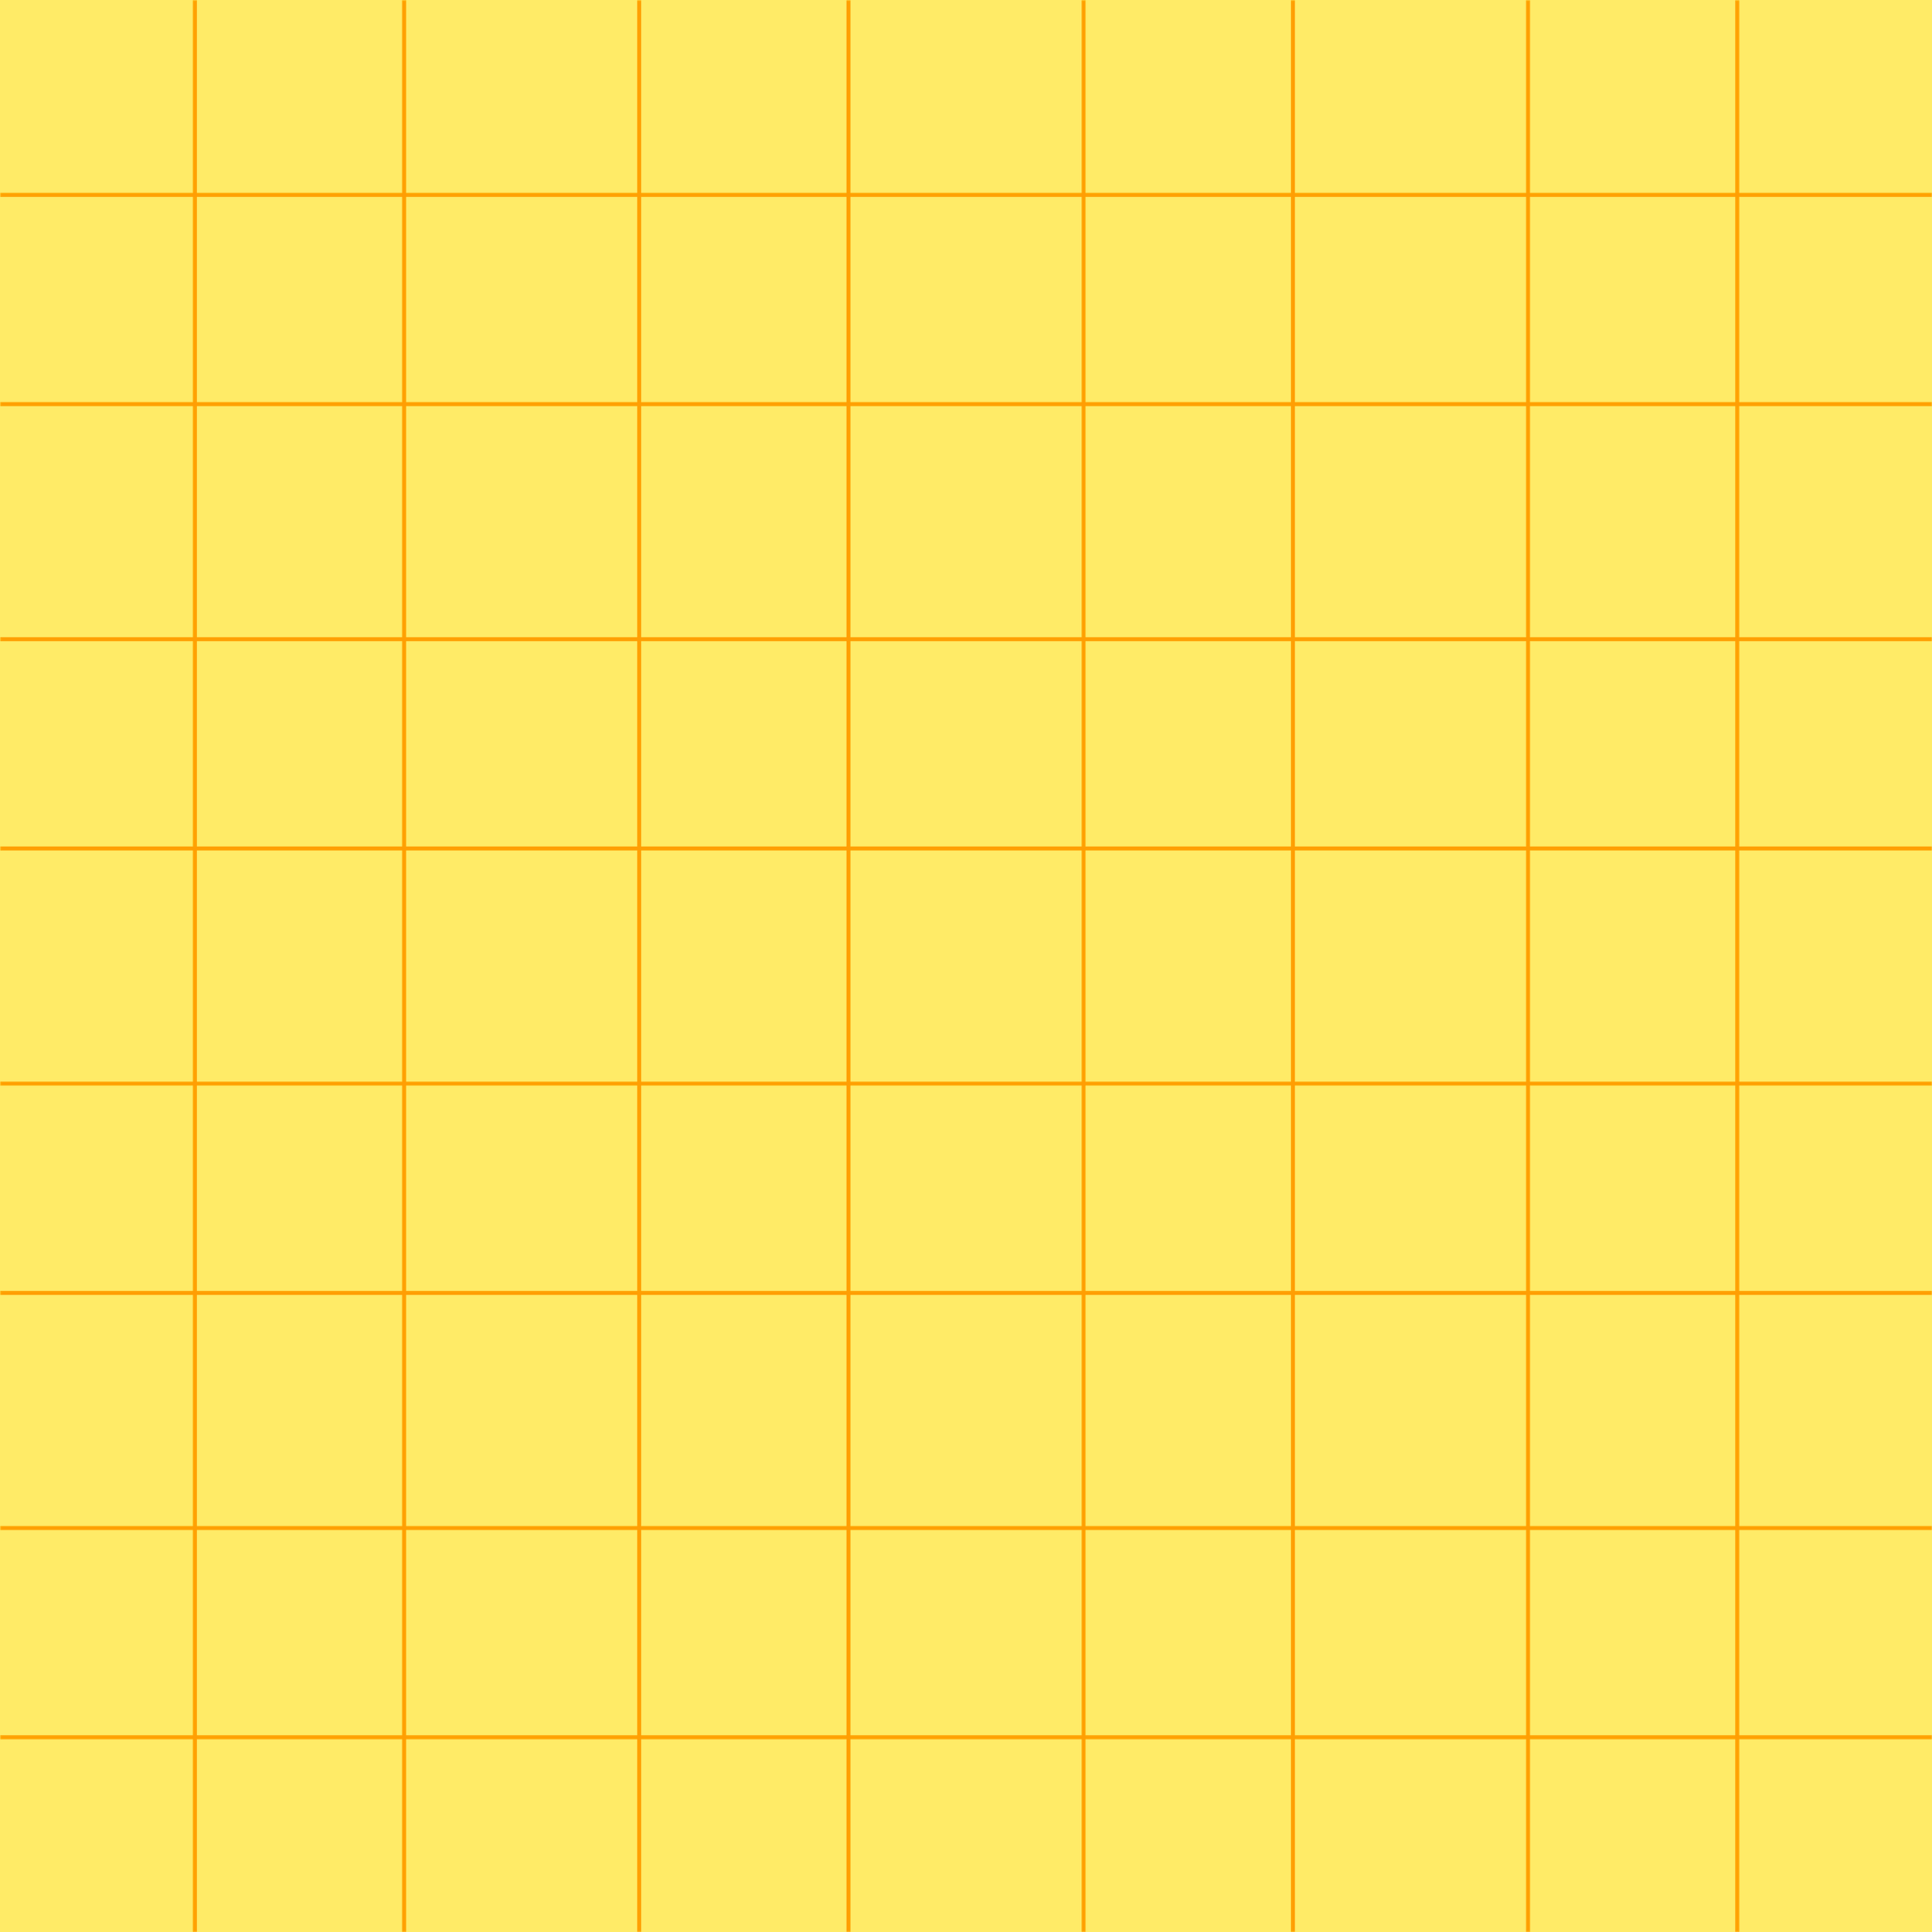
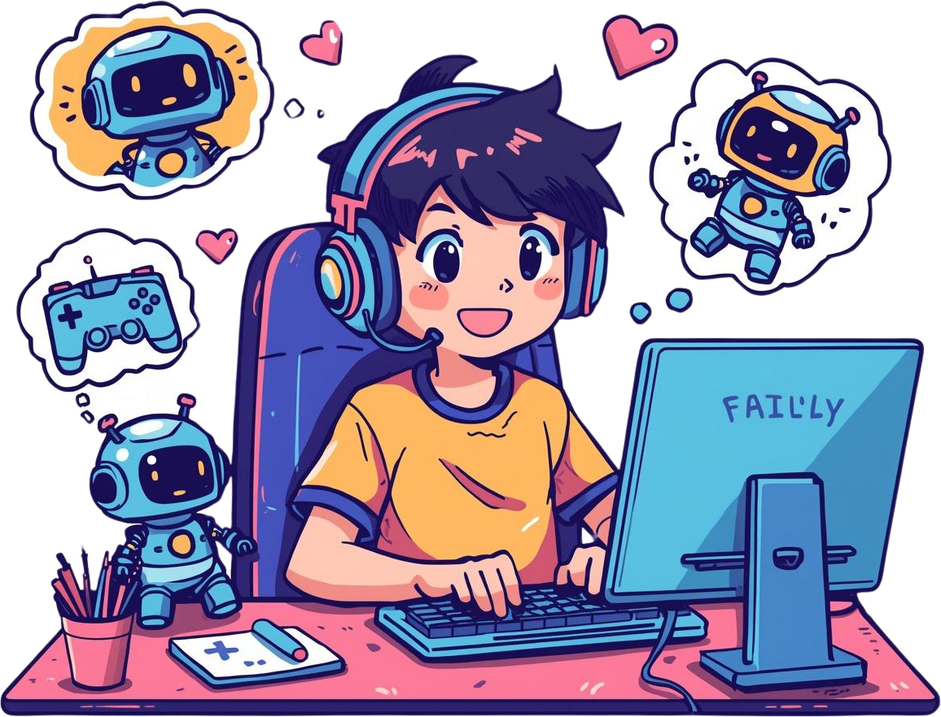
How AI Makes Games Smarter and More Fun
AI Game Developer Series
Day 6: AI Game Developer – Model Integration

Slide 2
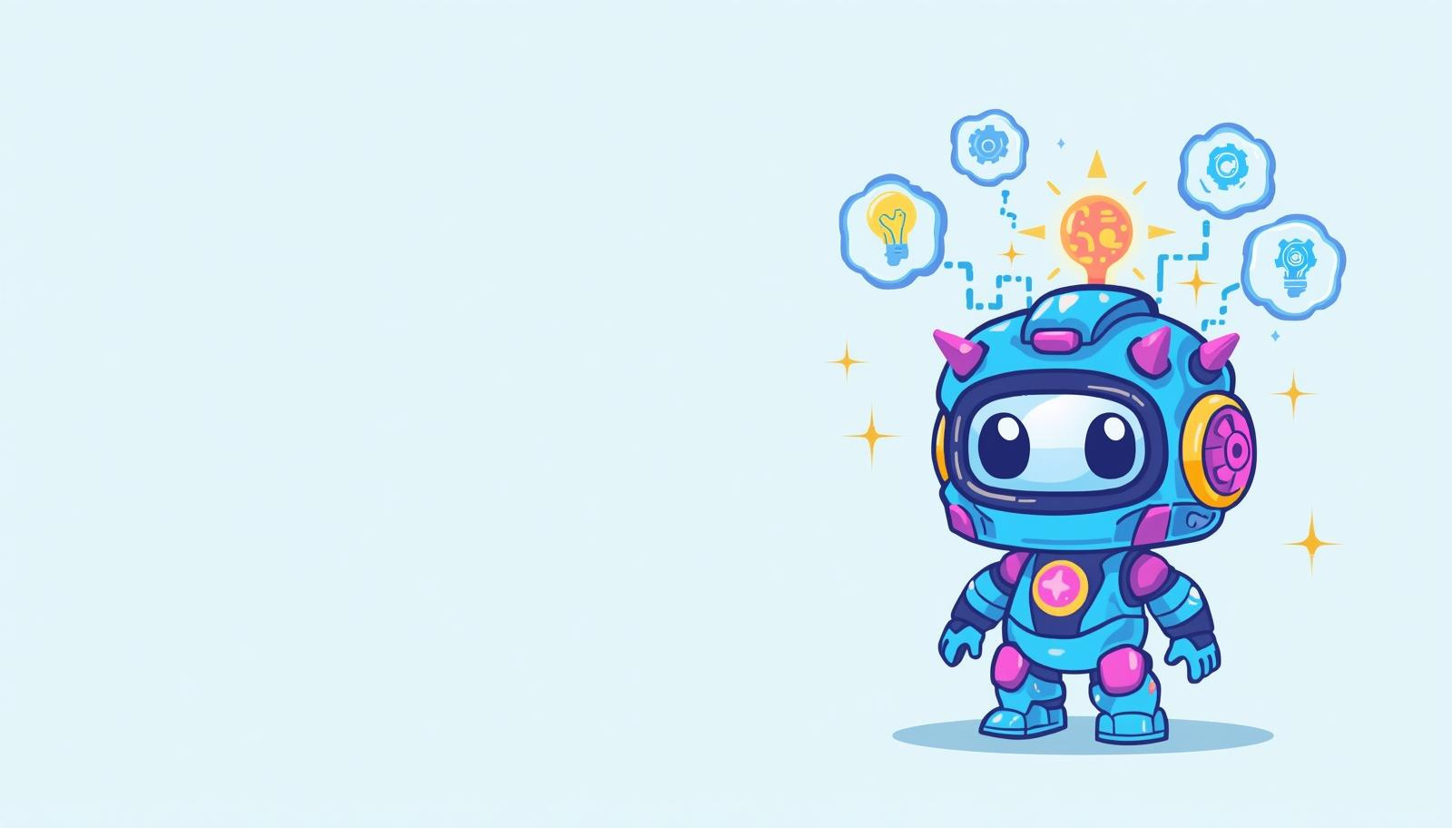
Smart Game Brains!
What is AI Model Integration?
AI Model Integration means putting smart AI brains into games so characters and opponents can think and learn! It's like giving your game characters superpowers to act smart!

Slide 3
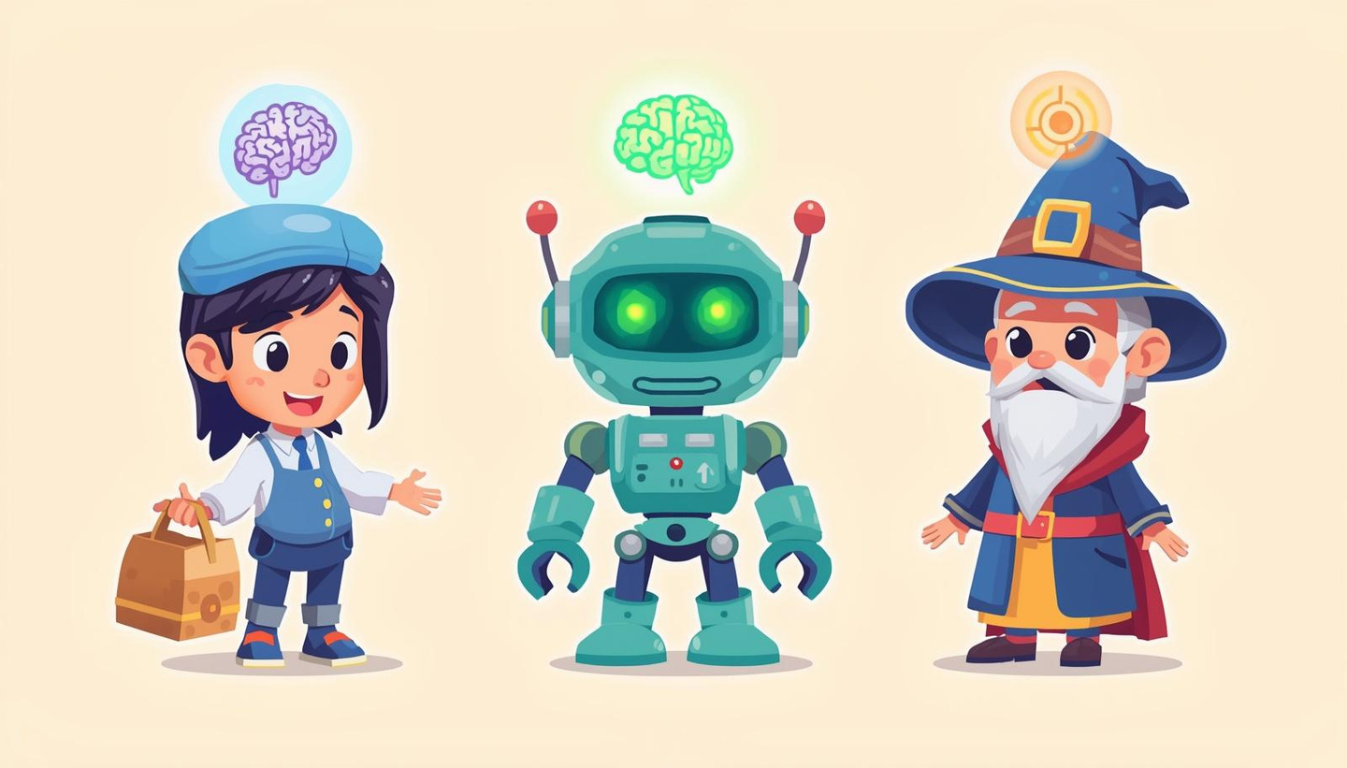
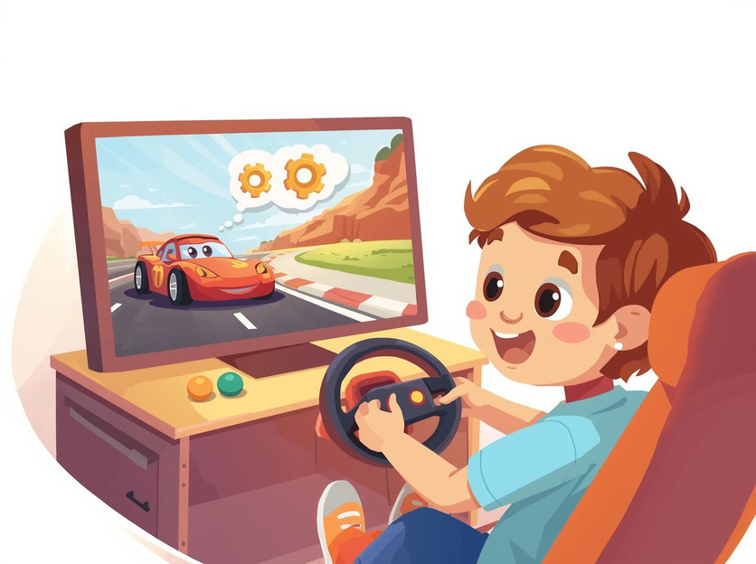
Day 6: AI Game Developer
Real-World AI in Games You Know
NPCs act like real people in Minecraft! Racing game opponents learn your moves and get harder! Smart teammates adapt to how you play!
35

Slide 4
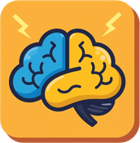

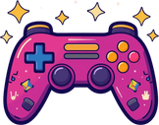
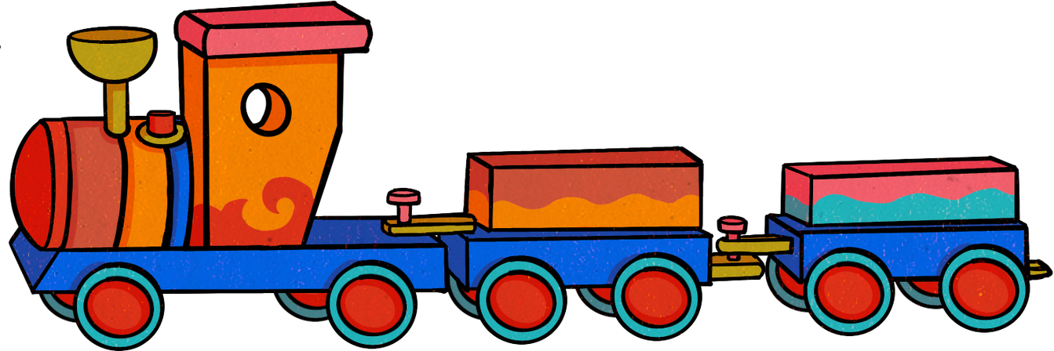

Smarter Opponents: AI can challenge you by learning your moves and getting better!
How AI Makes Games Smarter and More Fun
Realistic Characters: NPCs can talk, react, and behave like real players in your game!
AI gives games superpowers to think and learn!
Dynamic Game Worlds: AI changes the game depending on what you do — every playthrough is different!
Personalized Experiences: Games get more fun by adapting to your unique playing style!

Slide 5
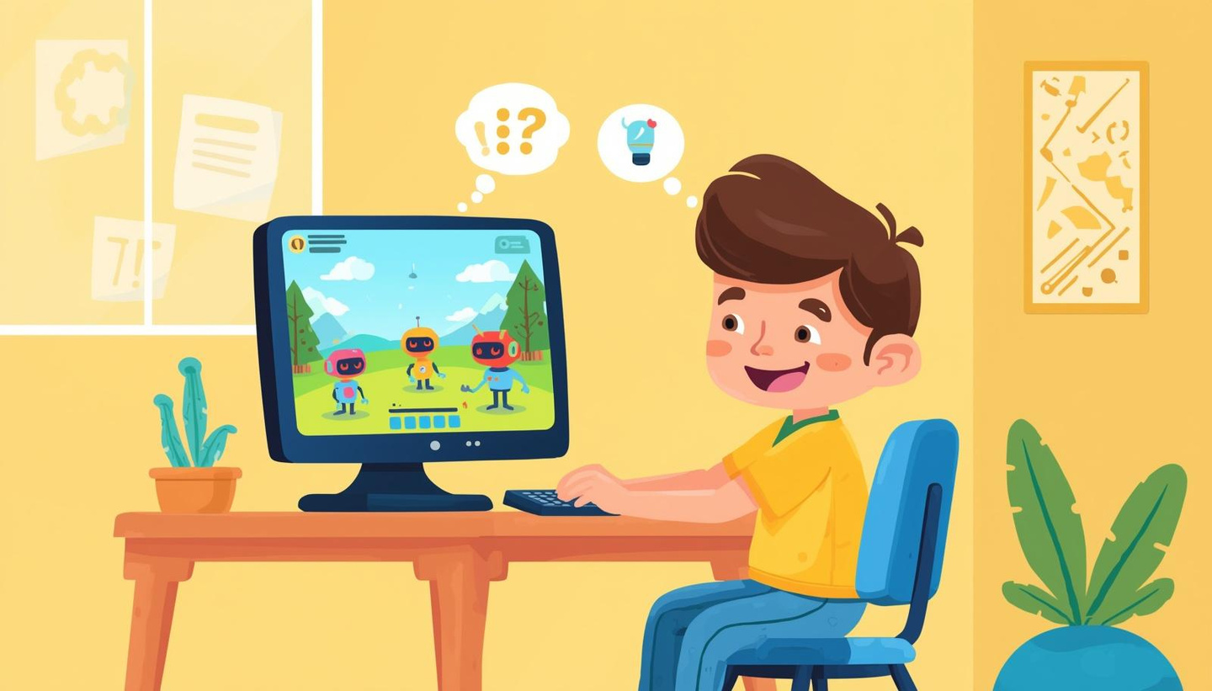
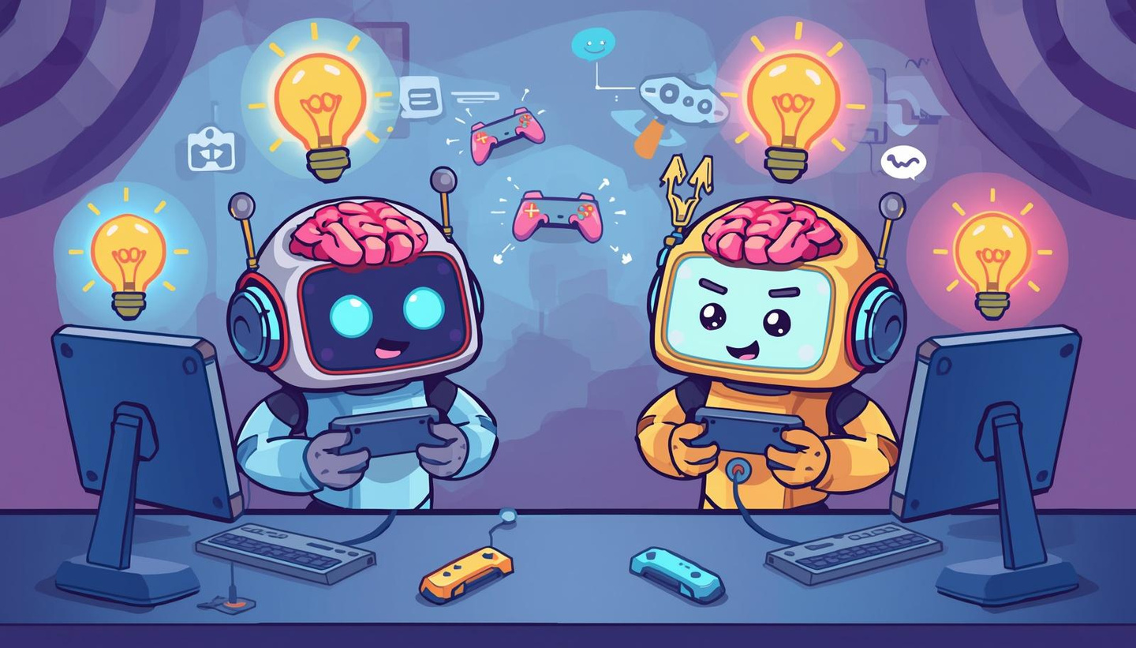
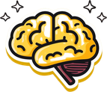
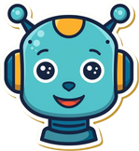
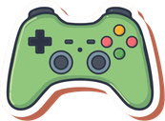
What smart game would YOU build?
Your Turn! Create Smart Games with AI
Make games that think!
You can be an AI Game Developer!
Let's create the next generation of smart games!

